Slide 1
Managing Risk, Safe Workplaces & And What to Do When Things Go Wrong
Presented by:
Danielle Waltz, Esquire
Jackson Kelly PLLC
500 Lee Street East, Suite 1600
Charleston, WV 25301
304) 340-1000
Email: dwaltz@jacksonkelly.com
Website: www.jacksonkelly.com
Rosary A. Hernandez
Tiffany & Bosco PA
2525 E Camelback Rd 7th Fl
Phoenix, AZ 85016-9240
(602) 452-2735
Email: RAH@tblaw.com
Website: www.tblaw.com

Slide 2
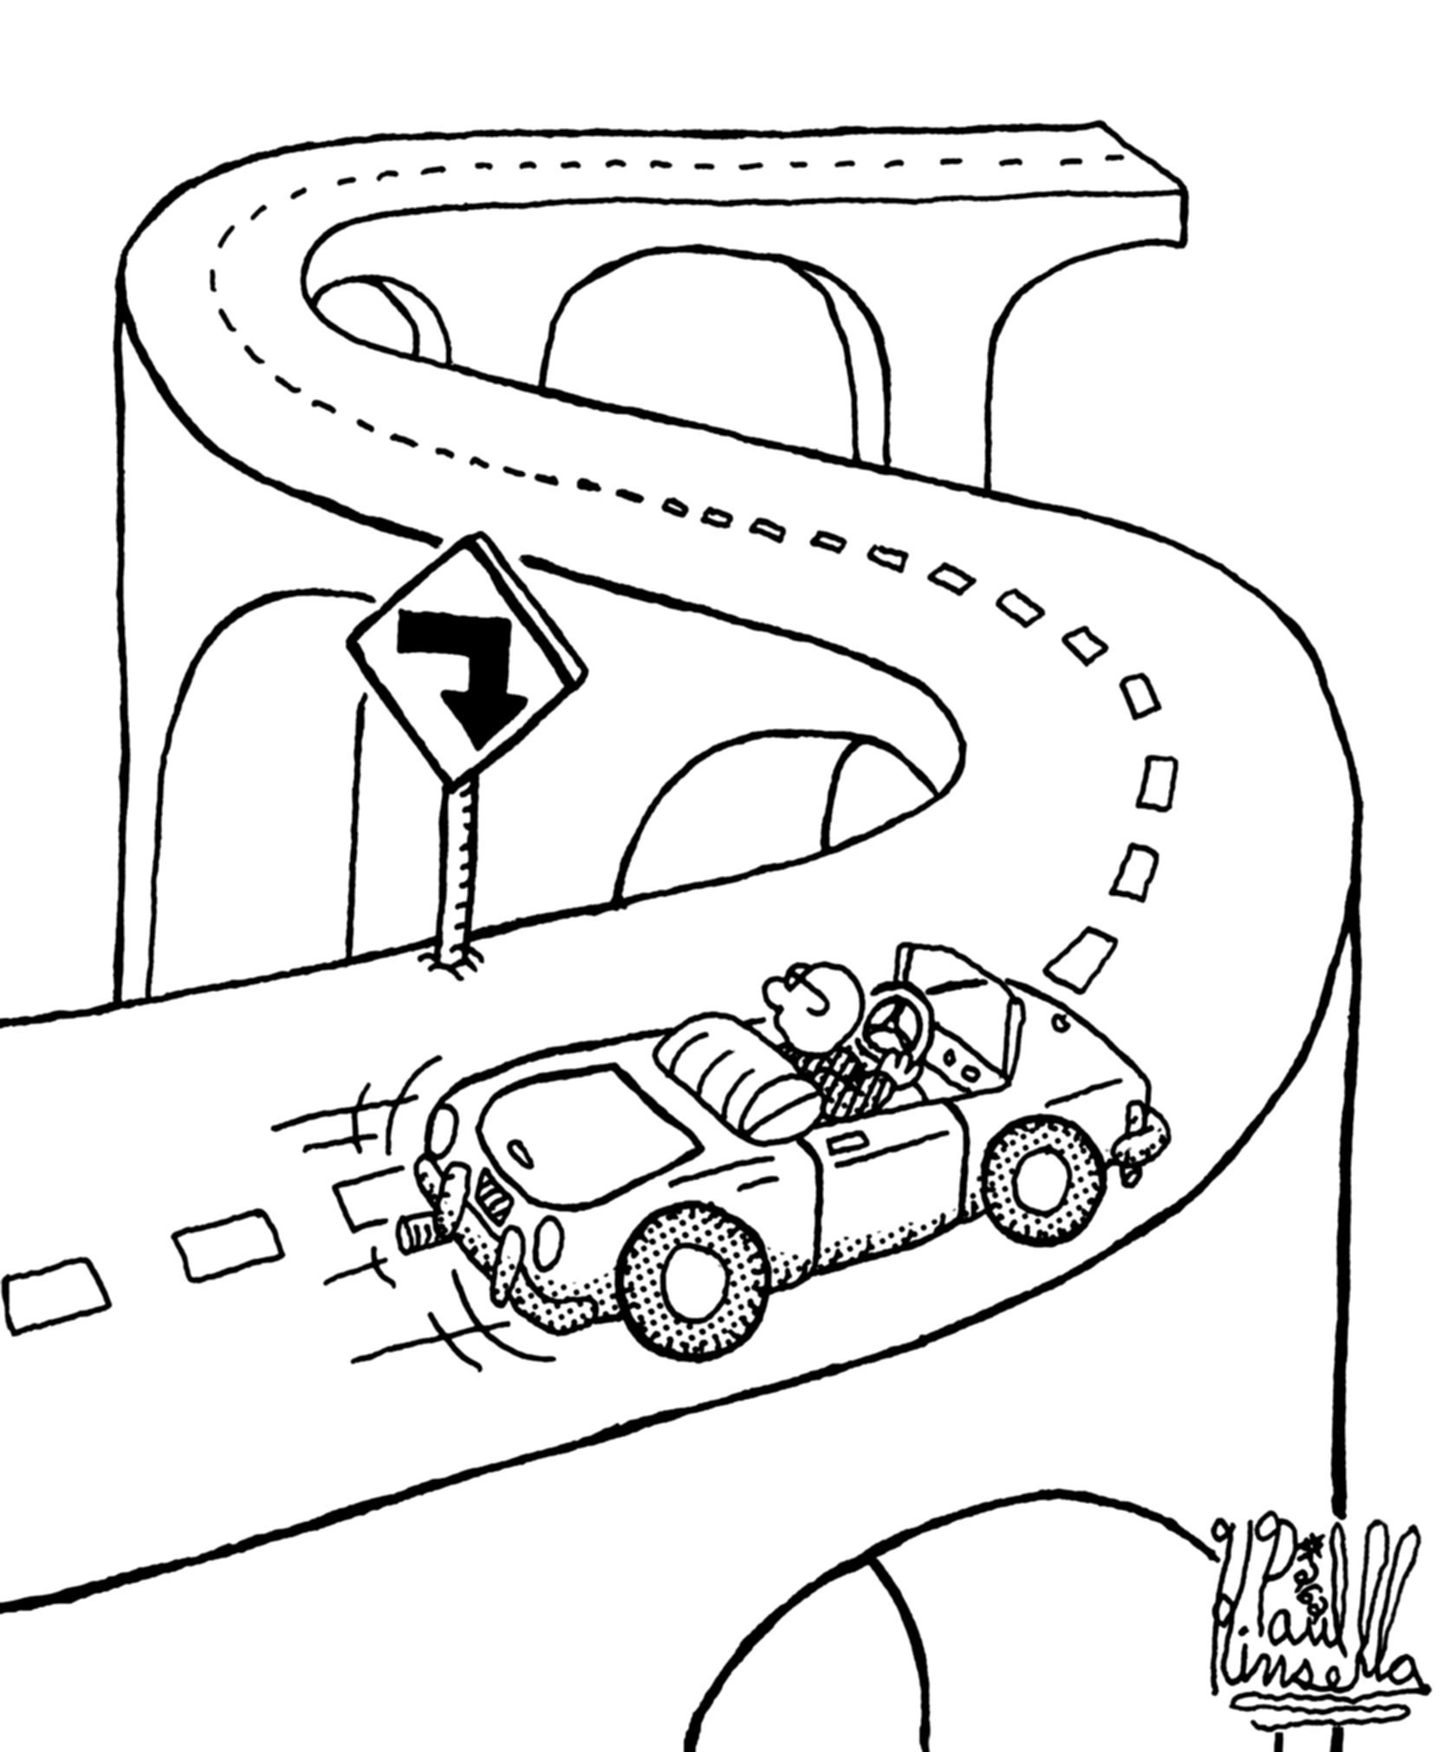

Slide 3
How To Avoid Getting Sued
Quality Design --- Attention to Detail
Quality Client Service
Documentation, Documentation, Documentation
Discuss with Counsel Before the Suit is Filed

Slide 4
What’s in Your Contract?
Clear Scope of Services
Limitation of Liability
Waiver of Consequential Damages
Dispute Resolution
Arbitration or Litigation or Both
Ne

Slide 5
Mediation & Arbitration
A Chance to Put Out the Fire
What’s in Your Contract?

Slide 6
Mediation & Arbitration
Any and all claims and controversies arising out of or relating to this contract shall be submitted to mediation and to arbitration as follows. Any controversy or claim arising out of or relating to this contract, or the breach thereof, shall be submitted to mediation, according to the mediation rules of the American Arbitration Association, as a condition precedent to being submitted to arbitration. If the claim is not settled by mediation then it shall be submitted to arbitration administered by the American Arbitration Association under its Construction Industry Arbitration Rules, and judgment on the award rendered by the arbitrator(s) may be entered in any court having jurisdiction thereof.

Slide 7
Dispute Resolution
STEP NEGOTIATION
MEDIATION
ARTITRATION OR LITIGATION

Slide 8
Step Negotiation
“New Face Makes the Deal”
Project Managers must meet to discuss
Executives of each party must meet to discuss

Slide 9
Mediation
“Chance to Put Out the Fire”
Professional Mediator
Voluntary Settlement

Slide 10
Arbitration or Litigation
“Field of Battle”
Pros and Cons of Arbitration and Litigation
Creative Contract Drafting

Slide 11
Redesign Costs
Who pays to redesign when the project goes over budget?
American Institute of Architects
Requires preparation of preliminary estimate of “Cost of the Work” but does not make clear who bears cost of redesign
Does not warrant that bids will not vary from estimate
Requires redesign at no additional cost to owner in exchange for limiting liability to owner
Engineers Joint Contract Documents Committee
EJDC E-500 deals with redesign costs separately from additional services
Design professional to correct design deficiencies at no cost to owner unless the deficiency in design is the result of inaccurate information provided by owner
Revise standard forms to clearly allocate cost of redesign

Slide 12
Can the Contractor Sue You?
The GC can’t sue me, I don’t have a contract with her.
West Virginia = Yes, GC can sue your. (Eastern Steel)
Ohio = Maybe. (Case law confused. Condo Owners not allowed to sue architect. Spring Creek, 2008)
Pennsylvania = Yes, GC can sue you. (Bilt-Rite)
Virginia = No. (Waytec)

Slide 13
Can the Contractor Sue You?
Examples of Other States = Yes
Georgia (Robert & Co.)
Tennessee (John Martin Co.)
Florida (Hewitt-Kier Constr.?)
Kentucky (Presnell Constr.)
“[T]he reality of modern construction litigation is that contractors routinely assert negligence claims against design professionals and courts are willing to entertain a tort claim for economic loss in the form of negligent misrepresentation.” Architect and Engineer Liability: Claims Against Design Professionals, p. 6-30 (4th ed., 2013)

Slide 14
Documentation, Documentation, Documentation!
You cannot win if you have no evidence.
It is easier to persuade an angry client if you have evidence.

Slide 15
Important Documentation
All design decision-making documents.
Change orders.
Revisions of any kind.

Slide 16
Important Documentation
The Contract!
Specs & Drawings
Progress Meeting Minutes
RFIs
Submittals
Mock-ups (yours and the contractor’s)
Schedules
Photos

Slide 17
Document Owner Decisions
Formal Contract Addenda (of course!)
Written messages
Phone Slips
Answer machine tapes
Voicemail
Phone notes
Emails
Can you save or document a text message?
If not, should you use that form of communication?

Slide 18
Legal Duty to Preserve Evidence…
EVEN BEFORE THE LAWSUIT IS FILED
Paper records and documents
Computer files, CAD files, BIM files, and emails

Slide 19
Federal Court
Required to produce “a copy of… All documents, electronically stored information, and tangible things that are in the possession, custody, or control of the party and that the disclosing party may use to support its claims or defenses….”
“A party need not provide discovery of electronically stored information from sources that the party identifies as not reasonably accessible because of undue burden or cost.”

Slide 20
Zubulake v. UBS Warburg LLC
The most famous case is Zubulake v. UBS Warburg LLC, 220 FRD 212, 217 (S.D.N.Y.) (“Zubulake IV”), wherein the Court stated:
Anyone who anticipates being a party or is a party to a lawsuit must not destroy unique, relevant evidence that might be useful to an adversary. While a litigant is under no duty to keep or retain every document in its possession, it is under a duty to preserve what it knows, or reasonably should know, is relevant in the action, is reasonably calculated to lead to the discovery of admissible evidence, is reasonably likely to be requested during discovery and/or is the subject of a pending discovery request.

Slide 21
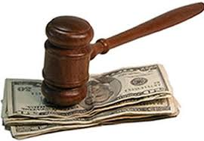
What To Do When You Get Sued ?
Get mad.
Get over it.
Get back to work.
Notify your Insurance agent.
Call your lawyer.
Don’t call the Plaintiff.

Slide 22
What To Do When You Get Sued?
Immediately identify who has documents, including electronic documents, that must be saved.
Issue a Litigation Hold Notice to all employees likely to have relevant evidence.
Accumulate and organize the project file and all other records in a central location.
Don’t call a group meeting to discuss.

Slide 23
What Is A Lawsuit?
Three phases
Initial Response
Discovery
Trial
Who Will Be Involved?
How Long Will It Take?
What Will I Have To Do?
What Will My Partners/Employees Have To Do?
What Will This Cost?

Slide 24
Time Limitation on Filing Lawsuit?
Most states have enacted some form of statutory protection for construction companies which require notice and the opportunity to cure construction defects in new residential construction or improvements and repairs to existing structures.
Several jurisdictions have adopted construction defect-specific statutes, while other jurisdictions have codified limitations on certain actions, including actions based on construction defects.

Slide 25
Statutes of Limitations by States’ Statutes
Alabama | 2 years after cause of action arises (AL ST § 6-5-221) | Iowa | 15 years after improvement (IA ST § 614.1)
Alaska | 10 years after substantial completion (AK ST § 09.10.054) | Kansas | Notice tolls applicable SOL (KS ST 60-4702)
Arizona | 8 years after substantial completion (AZ ST § 12-552) | Kentucky | Notice tolls applicable SOL (KY ST § 411.258)
California | 10 years after substantial completion (CA CIVIL § 941) | Louisiana | 1 year after discovery of defect (LA R.S. 9:3145)
Colorado | SOL tolled until 60 days after notice is properly served (CO ST § 13-20-805) | Maine | None (Review case law instead)
Connecticut | 3 years after cause of action accrues unless a period of limitation is tolled (CT ST § 47-277) | Maryland | 2 years after defect discovered or should have been discovered; or 2 years after expiration of warranty, whichever first (MD REAL PROP § 10-204)
Delaware | None (Review case law instead) | Massachusetts | 6 years from improvement, or substantial completion of improvement and taking of possession (MA ST 260 § 2B)
D.C. | 10 years from date of improvement to real property (DC CODE § 12-310) | Michigan | 6 years from improvement with occupancy or 1 year from discovery of defect; not to exceed 10 years from improvement (MI ST 600.5839)
Florida | Written notice tolls SOL (FL ST § 558.004) | Minnesota | None (Review case law instead)
Georgia | Notice will toll applicable SOL (GA ST § 8-2-38) | Mississippi | 6 years from improvement (MS ST § 15-1-41)
Hawaii | SOL stayed by offer to repair or mediation (HI ST § 672E-8) | Missouri | Notice tolls applicable SOL (MO ST 436.356)
Idaho | None (Review case law instead) | Montana | None (Review case law instead)
Illinois | 4 years after person knew or reasonably should have known of act or omission; 10-year limit in any case, but person who discovers in 10 years has additional 4 years; exceptions made for persons with disabilities (IL ST CH 735 § 5/13-214) | Nebraska | 4 years after improvement, unless defect discovered w/in 1 year of expiration, then 2 years from date of discovery; no more than 10 years after act giving rise to cause of action (NE ST 25-223).

Slide 26
Statutes of Limitations by States’ Statutes Continued
Nevada | Notice tolls applicable SOL (NV ST 40.695) | Tennessee | 4 years after substantial completion of improvement (TN ST § 28-3-202)
New Hampshire | Notice tolls applicable SOL (NH ST § 359-G:4) | Texas | None (Review case law instead)
New Jersey | None (Review case law instead) | Utah | None (Review case law instead)
New Mexico | 10 years from substantial completion of improvement (NM ST § 37-1-27) | Vermont | None (Review case law instead)
New York | None (Review case law instead) | Virginia | 5 years after substantial completion of improvement (VA ST § 8.01-250)
North Carolina | 6 years from substantial completion of improvement (NC ST § 1-50) | Washington | None (Review case law instead)
North Dakota | None (Review case law instead) | West Virginia | None (Review case law instead)
Ohio | Notice tolls applicable SOL (OH ST § 1312.08) | Wisconsin | None (Review case law instead)
Oklahoma | None (Review case law instead) | Wyoming | 10 years after substantial completion of improvement (WY ST § 1-3-111)
Oregon | None (Review case law instead) | United States | None (Review case law instead)
Pennsylvania | None (Review case law instead) | Guam | 10 years after substantial completion (7 G.C.A. §§ 11309,11310)
Rhode Island | None (Review case law instead) | Puerto Rico | None (Review case law instead)
South Carolina | 8 years after substantial completion of improvement (SC ST § 15-3-640) | Virgin Islands | 7 years after substantial completion of improvement or 14 years for latent deficiencies (5 V.I.C. § 32b)
South Dakota | Notice tolls applicable SOL (SD ST § 21-1-16)

Slide 27
Time Limitation for Filing Lawsuit?
When does the time period begin to run?
Typically, the statutory period commences when the cause of action accrues. When does the cause of action accrue? Depends on the case law and statutes in each state.
Five likely options:
(1) when the wrongful act occurred;
(2) when the project was completed;
(3) when the damage occurred;
(4) when the plaintiff knew or should have known of the damage; and
(5) when the plaintiff knew or should have known of the damage and the identify of the wrongdoer.

Slide 28
Contractor’s Standard of Care
Contractor’s have a duty to inspect existing work to determine suitability for subsequent work.
It is the contractor’s responsibility to asses the quality of work already completed to determine if it is in property condition to receive subsequent work.
A general contractor is responsible for inspecting subcontractor work to determine whether it is adequate for purposes of allowing another subcontractor to perform work that will cover it or otherwise rely upon the previously installed work.

Slide 29
Contractor’s Standard of Care
A contractor’s duty of care extends only to foreseeable hazards that the defendant contractor knew or should have known existed. This does not extend to accidents that happened because of unforeseeable, extraordinary circumstances.
(Woods v. Qual-Craft Indus., Inc., 648 N.E.2d 1198, 1202 (Ind. App. 1995); Collins v. J. A. House, Inc., 705 A.2d 568, 573 (Ind. App. 1999); and De Bock v. American Bridge Co., 131 A.D. 480, 115 N.Y.S. 461 (1909)).

Slide 30
Contractor’s Duty of Care
Contractor’s have a duty to guard against foreseeable harm. But what if a superseding event caused the accident? Then the defendant contractor is potentially off the hook.
Intervening negligence cuts off liability, and becomes known as a superseding cause, if it is determined that the intervening cause was not foreseeable and the results which it caused were not foreseeable.
Martinez v. Vintage Petroleum, Inc., 68 Cal. App. 4th 695, 80 Cal. Rptr. 2d 449 (1998) (extraordinary negligence by plaintiff's co-worker's relieved the owner of liability despite its negligence in causing a foreseeable injury).

Slide 31
Contractor’s Duty to Inquire
Contractor’s have a duty to clarify contractual requirements.
In Interwest Const. Brown, 29 F.3d 611 (Fed. Cir. 1994), the lowest bidding contractor lost the battle against the owner as to who would handle the cost of an air conditioning system. The contract required that the contractor provide an air conditioning system capable of producing 900 tons of cooling capacity that used low ODF refrigerants, or could be converted to use low ODF refrigerants. The problem arose when it was found that after conversion, the system was unable to operate at a 900-ton capacity. Consequently, the owner rejected the system.
The contractor claimed that the specifications were ambiguous because they did not clearly state that 900-ton capacity was required in both low ODF refrigerant systems and converted systems. The contractor submitted a claim for equitable adjustment in the amount of $72,293—the cost of procuring the upgraded system. The contracting officer’s denial of the claim was upheld by the Board of Contract Appeals.
The court affirmed that (1) the contract was clear and unambiguous, (2) even if the contract was ambiguous, the ambiguity was patent and it was the contractor’s duty to clarify the contractual requirements, and (3) contractor’s interpretation of the contract was unreasonable, and therefore, even if there was a latent ambiguous, it could not recover.

Slide 32
Design Professional Standard of Care
General Statement (Bruner & O’Connor):
The design professional's standard of care is deceptively simple. Like many standards having wide application, the designer's standard references a mean. The designer owes a duty to perform services with the degree of skill, learning and experience that ordinarily is possessed by similarly situated professionals in the community.¹ The designer's standard of care requires neither perfection nor a warranty of a particular result. Rather, it expresses an expectation that the designer will discharge her professional duties with the care ordinarily exercised by others of her profession.
§ 17:10.Standard of care: Duty of care, 5 Bruner & O'Connor Construction Law § 17:10

Slide 33
Design Professional Standard of Care
AIA:
The most common form of agreement between owner and architect, AIA Document B141-1997 contains little in the way of general statements regarding the standard of care to be provided by the architect in carrying out his duties. The closest the AIA documents come to addressing the standard of care is paragraph 1.2.3.2 of the B141 which merely restates the common law standard:
1.2.3.2 The Architect's services shall be performed as expeditiously as is consistent with professional skill and care and the orderly progress of the Project. …
§ 17:10.Standard of care: Duty of care, 5 Bruner & O'Connor Construction Law § 17:10

Slide 34
Design Professional Standard of Care
EJCDC:
A standard of care is, however, set forth in the EJCDC's owner-engineer agreement:
The standard of care for all professional engineering and related services performed or furnished by ENGINEER under this Agreement will be the care and skill ordinarily used by members of ENGINEER's profession practicing under similar conditions at the same time and in the same locality. ENGINEER makes no warranties, express or implied, under this Agreement or otherwise, in connection with ENGINEER's services.
EJCDC Document No. 1910-1, ¶ 1.1.
§ 17:10.Standard of care: Duty of care, 5 Bruner & O'Connor Construction Law § 17:10

Slide 35
Design Professional Standard of Care
National – Regional – Local Standard:
See Abramovitz, Architects and The Law, in 1 The Architect's Handbook of Professional Practice § 1.13 at 27-28 (1994) ("The professional standard of care is evolutionary in nature. For example, some jurisdictions now interpret in the same community to mean the entire United States. These jurisdictions reason that contemporary communication and technology and a high degree of mobility in American society reduce the impact of regional variations."). Common educational requirements, common licensure requirements, and burgeoning multi-state design practices enhance the trend toward a common national standard of care. See also Parsons Main, Inc., ASBCA Nos. 51355, 51717, 02-2 BCA (CCH) 4 31, 886 (rejecting a local area standard for architects in favor of a national standard).
§ 17:10.Standard of care: Duty of care, 5 Bruner & O'Connor Construction Law § 17:10

Slide 36
Design Professional Standard of Care
The quintessential statement of design professional’s standard of practice:
The responsibility resting on an architect is essentially the same as that which rests upon the lawyer to his client, or upon the physician to his patient, or which rests upon any one to another where such person pretends to possess some skill and ability in some special employment, and offers his services to the public on account of his fitness to act in the line of business for which he may be employed. The undertaking of an architect implies that he possesses skill and ability, including taste, sufficient to enable him to perform the required services at least ordinarily and reasonably well; and that he will exercise and apply, in the given case, his skill and ability, his judgment and taste, reasonably and without neglect. But the undertaking does not imply or warrant a satisfactory result. It will be enough that any failure shall not be by the fault of the architect. There is no implied promise that miscalculations may not occur. An error of judgment is not necessarily evidence of a want of skill or care, for mistakes and miscalculations are incident to all the business of life.
Coombs v. Beede, 89 Me. 187, 36 A. 104, 104–05 (1896)

