Slide 1
Company Culture & You
Why Culture Matters
Notes:
Thanks for joining me today to discuss company culture and why it matters. Culture is a compelling topic for any industry, but we will discuss it today as it relates to our industry – construction. My objective for you today is to reflect on and consider your company culture.

Slide 2
#1
#2
Notes:
In 2017 Hays Recruiting issued a report based on data they collected from over 2100 people across 16 different industries (including construction), multiple generations, and all levels within organizations. The report titled, “What People Want, Job Satisfaction Takes More Than Just a Paycheck”, found…
Salary is most important factor in accepting a job offer or staying in a current role – 80% say they are prepared to leave their current position for the right offer
Company Culture is #2 most important factor – Company culture is the main reason people would consider leaving their current role,
Across every demographic, top 4 elements of good company culture are the same: open communication, work-life balance, strong leadership, and company values – 90% say open communication is the most important aspect of good culture.
While salary was found to the biggest factor in accepting a role, Employees are looking for more of a total package of competitive compensation which includes clear career growth opportunities, a great culture, and benefits that support their goals, while perks such as free food, onsite recreational activities, are considered the “cherry on top” or a bonus, not the core desires of the American workforce.

Slide 3
Notes:
If company culture is the #2 reason people state for leaving their jobs…How important is culture to employees in the construction industry? The same report by Hays recruiting found that in construction…
Culture is the main reason given for leaving a current role, 34% list culture as main motivator, and 47% of active job seekers say it is the reason they are leaving their current role
Construction industry employees rate Company values 20% more important than other functions, which seems to indicate they are looking for a company that aligns with their own values, somewhere they feel they “fit”.
Construction professionals rate working with the right team and strong leadership higher than the average of other functions.
Great benefits factor very high for a good company culture, in the construction industry
Across generations, millennials, gen x, and boomers, all agree that company culture is important in the construction industry

Slide 4
Notes:
So we have data that says culture is important. But…what do we mean by Company Culture? What is it?
In its most basic form: culture refers to the values and attitudes of employees in the business or organization. The formal and informal values, behaviors, and beliefs practiced in an organization. The norms or “How things get done” “The rules of the game”
Executive Coach and Author, Peter Ashworth says, “A company’s culture is the only truly unique identifier. It is like a finger print, it may be similar to others, but is uniquely distinct to your business. Everything else (products, strategies, marketing, even innovations) can be replicated, but the only truly unique identifiers are the values and norms of the organization – its culture, or personality.”

Slide 5
Notes:
How would you define your company culture? Can you describe it? Is it recognizable to others; your employees, your customers, your competitors?
In the construction industry company culture may be what distinguishes a GC or sub, from others. What are you known for, what does your company stand for?

Slide 6
Notes:
A strong company culture can drive better company performance, but it can just as easily impede change and innovation, paralyze decision making, and demotivate employees. This is true because a strong culture can be restrictive, overbearing, and mired in “the way we have always done things” and not open to new ways of doing things and evolving the business over time.
There has to be enough balance and flexibility that employees understand and embrace the culture, but are not crippled by it in doing their jobs. There should be a few core values that really guide all the actions of the company from hiring to how customers are served. Those values must be clearly articulated and demonstrated by leadership, or the rest of the company will most certainly not buy-in.

Slide 7
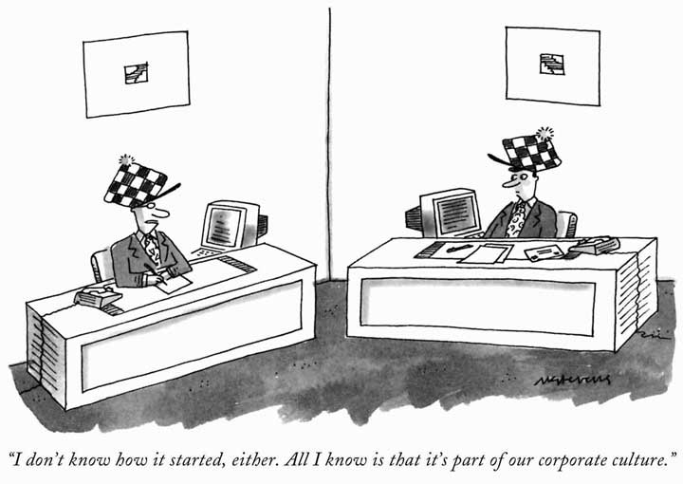
Notes:
In order to work well with any organization it is important to understand their company culture. This cartoon is a great way to show that just because a company culture is strong does not mean that it is understood, or even a good culture!

Slide 8
Components of great culture
Values
Place
Practices
Vision
People
Narrative
Notes:
Author, John Coleman identifies “6 common components of a great corporate culture” in a Harrvard Business Review article.
Vision – a vision or mission statement that orients every decision employees make – foundational element of culture
Values – values are the core of a company’s culture. These guide the behaviors and mindsets needed to achieve the vision. These need to be authentic, not just words posted on the wall or the back of a business card.
Practices – the actions of the company in all things they do: these actions should be informed by the values. Review criteria, promotion practices, and the daily operating principles.
People – companies cannot build coherent culture without people who share or are willing to embrace the core values. People stick with cultures they like, and leave those they don’t.
Narrative – an organizations unique history, it’s story. The ablity to identify it’s history and celebrate it. History is very powerful when identified, shaped, and retold as part of the company’s ongoing culture. The past informs the future.
Place – Place shapes culture. Geography, architecture, or aesthetic design all impact the values and behaviors of people in the workplace.

Slide 9
Notes:
Why is culture important? Why does it matter?
A study conducted by researchers from Duke and Columbia business schools in which they surveyed more than 1400 CEOs and CFOs found:
Overwhelmingly, the executives said that healthy corporate culture is essential for a company to thrive.
More than 90% said that culture was important at their firms.
92% said they believed improving their firm’s culture would improve the value of the company.
More than 50% said corporate culture influences productivity, creativity, profitability, firm value and growth rates.
Great culture leads to more productive employees which translates to bottom line results. Companies with strong culture, have better overall performance.

Slide 10
What Makes a Great Company Culture?
Notes:
What do think makes a great company culture? Think about the places you have worked. What seemed like a good culture, and what maybe seemed like a bad culture? What does a great culture look like? Are there examples?
Do you have examples in your company or places where you have worked?
Diverse points of view are freely shared, and teams emphasize the best interest of the company as opposed to self-interest
Feedback can be given without fear of repercussion
There is trust, teamwork, great communication at all levels, accountability, recognition and sharing of success
Emphasize integrity and collaboration

Slide 11
Top Work Places - Construction
McHugh
Power Construction
Power Home Remodeling
Arco/Murray National Construction
Ozinga
John Burns Construction
Mortenson
Notes:
Values and qualities such as:
Commitment to customers and team members
People matter, relationships matter
Have fun, is a company value
Teamwork, respect, accountability
Continuous improvement, value learning
Trust, Service, Stewardship
Treat people like their part of the family
entrepreneurship

Slide 12
Constructions’ Unique Advantage
Notes:
In terms of the construction industry; it has been a long term patriarchal business. The industry is still dominated by family owned businesses, which can influence culture.
According to FMI, the fact that most construction companies are family owned is a distinct advantage for the company culture.
90% of construction companies are privately held
Many have been in business for 2 or 3 generations
Build cultures on values – not shareholder demands
Know who they are and how they behave

Slide 13
Culture & Reputation
Notes:
Companies with strong employee culture, have better overall performance. Great culture leads to more productive employees which ultimately translates to bottom line results.
Employee engagement – we have all heard the dismal statistics on employee engagement, company culture and cultural fit have a strong correlation here.
Motivation – teams with strong cultures tend to motivate, support, and encourage each other.
Culture can have an effect on a company’s’ reputation as well, both inside and outside the company, as a company to do business with and as an employer. If a company says integrity is important in their values statement, yet they demonstrate unethical behavior, this is most likely a sign that their culture is not positive and this will affect their reputation both inside and outside the company.

Slide 14
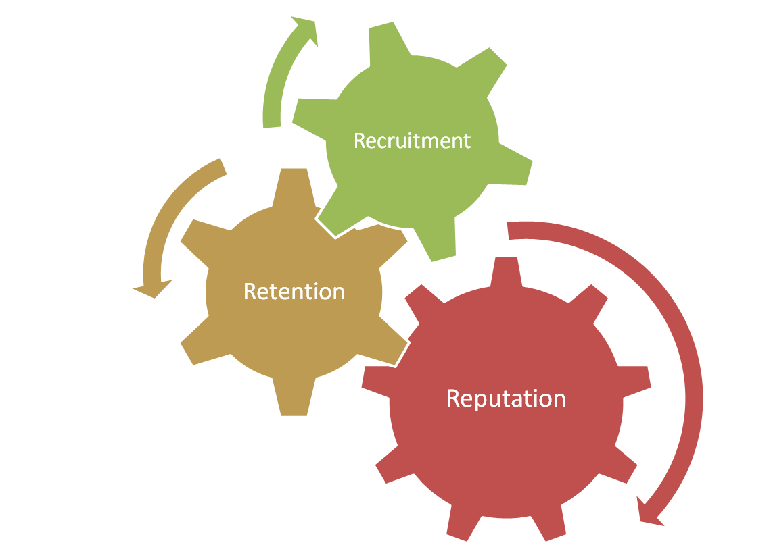
Leverage Culture to recruit and retain
Notes:
Recruiting and Retaining are opportunities to leverage company culture. Why did you, or your employees, go after and accept a position at your company, and what makes you or them, stay? In today’s tight job market, employers need to recognize the importance of company culture in recruiting and retaining. A positive Company culture can improve employee referrals; happy satisfied employees tell their friends and network how much they enjoy their job and what great place it is to work!

Slide 15
Notes:
Thank you to Jennifer Caceres, from Ozinga, who spoke this morning. This is a marketing video but provides some insight into culture at Ozinga.

Slide 16
Notes:
Ask audience - How do you learn about company culture?
Media, Current and Former employees, suppliers and subcontractors, company websites give information (that they company wants you to know – values, mission), Glass Door or other websites where current and former employees can rate and review companies.

Slide 17
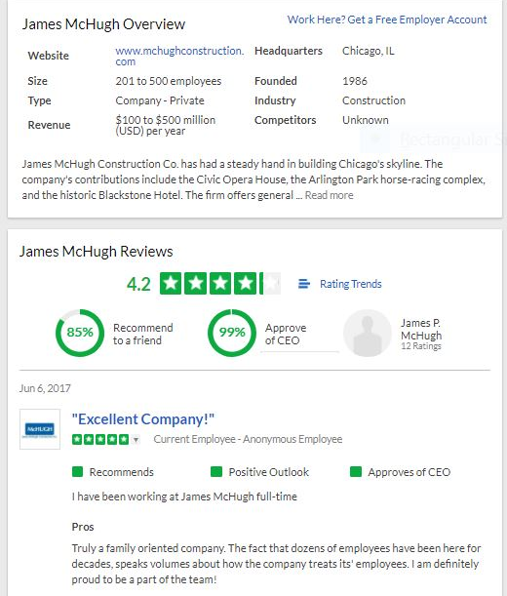
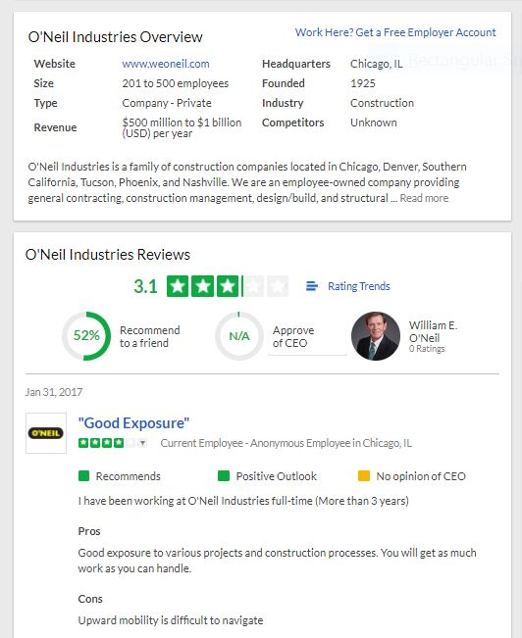
Notes:
Some examples of information on Glassdoor one very favorable outlook and the other more neutral. These are helpful when researching companies and trying to determine their culture. Do these rating and reviews align with the values of the company? Probably most effective to use them to inform questions you might ask in an interview situation.

Slide 18
Culture
Notes:
Company culture must be tended and nurtured liked a garden. Can’t control everything, but can be intentional about creating culture, and creating alignment around the culture.
“Walk the talk” on company values and keep them at the core of all they do
Stories become legends that are shared over time and inform the culture – good and bad
Look to and honor the past to protect the future
Very few companies are intentional about their culture – just let it happen
A company must define it’s culture or it will define itself – and likely not in a positive way.
I worked at a Corporation for many years that had a very “nice” culture – in fact new employees would often say, Wow! Everyone here is soooo nice. While many people were very nice, there was also a strong culture of passive/aggressive behavior. People were nice to your face and often said something entirely different behind your back, or pledged their support but didn’t follow through. People were not honest and it starts to create a culture of distrust, it can start in a team, but can become pervasive to the company, especially if leadership demonstrates this behavior as well.

Slide 19
What Can
We Do
Notes:
What can we do to help improve our own company culture?
We all have the power to change company culture for the better, regardless of position.
Sometimes we have to have the courage to speak up for what we believe, and help make it better.
Be self aware, aware of your behavior and affect on others: How are you contributing to the culture? Positive or Negative?
Be proactive in promoting diversity, and creating a culture that values everyone.
We can help create workplaces that reflect our values, and are places we really want to work. Places where work has meaning.
Let’s be sure we are cultivating culture where employees feel inspired and motivated; where employees are happy and feel they are an integral part of the company’s success.
There is no shortcut to good company culture, it is intentionally crafted and takes work to maintain, and it is critical for attracting and retaining a great team. Construction is an industry that appeals to many, the tangibility of the final product is attractive, and it is company culture that will ultimately persuade employees to stay.

Slide 20
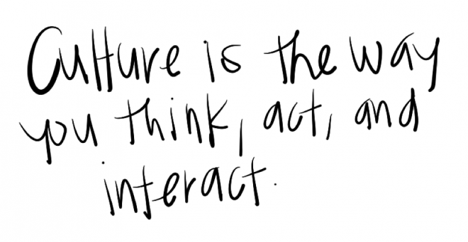

Slide 21
“Find a place where you feel like you belong, where you can be yourself & you’ll work hard every single day” – Simon Sinek
Notes:
Simon Sinek, author of Start with Why, is quoted as saying… This is the essence of cultural fit. Feeling like you belong, excited to be part of something bigger than just your role, feel pride in the company and what you do, feel like what you do matters and makes a difference to others, and you feel confident being who you are and bringing your whole self to work. Your values align with the company values. You feel as though what you do matters, that you are an integral part of the companies success This is cultural fit.
In keeping with our Survivor theme – FIND YOUR TRIBE!

Slide 22
Thank You!
If you enjoyed our presentation, please follow Constructing Opportunity, LLC on LinkedIn
Michaelann Agoranos – Principal
Constructing Opportunity, LLC
www.constructingopportunity.com
Notes:
Thank you for your time and attention today, any questions?
If you enjoyed our presentation please follow Constructing Opportunity, LLC on LinkedIn

