Slide 1
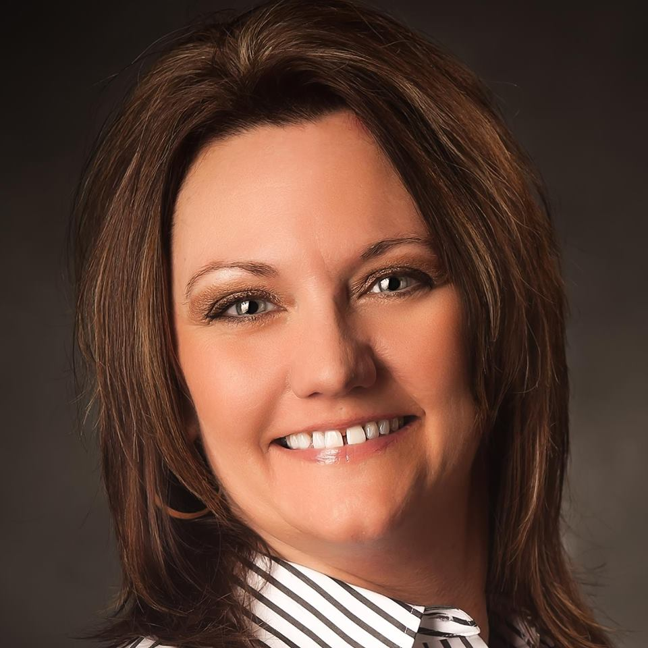
Midwest Region Director Candidate 2018-2020
Jodi Wiemerslage
Southeast Minnesota Chapter 346

Slide 2
My NAWIC Journey Jodi Wiemerslage
Joined SE MN Chapter 346 July 2013
Chapter President 2014-2016
Chapter Treasurer 2016-2018
STEAM Committee Chair
WIC Week Chair
PR Marketing/ Membership Chair
Block Kids Co-Chair
Midwest Region PR Marketing Chair 2016-2018

Slide 3
2015 Future Leader of the Year Jodi Wiemerslage
“The mission of the award is to recognize outstanding efforts of NAWIC members. The Future Leader of the Year Award is presented to a new member of NAWIC who has been actively involved in the association throughout her first two years.”
THANK YOU to Mary Becker for nominating me for this amazing award. Without the support of Mary and SE MN Chapter 346 I would not be where I am today in NAWIC. I am so honored and blessed to be surrounded by such empowering, beautiful women.
Be Inspired to Nominate Someone You Know – It Is Life Changing

Slide 5
Southeast MN Chapter 346 Jodi Wiemerslage
“NAWIC Chapter 346 is based out of Rochester, MN and encompasses Southeastern Minnesota. First chartered in 1993, our chapter is now 27+ members strong and growing. Our mission is to support and encourage the growth of the number of women in the construction industry through scholarships and educational opportunities.”

Slide 6
SE MN Chapter 346 Chartered in 1993 With the Support of the Minneapolis St Paul Chapter 164

Slide 7
Southeast MN Chapter 346

Slide 8
My Employer Jodi Wiemerslage, PM/Estimator
“Hunt Electric is a national design build electrical contracting firm grounded in the simple, powerful concept of performing efficient, quality work. Our loyalty is to our clients and our communities in more than 40 states”
Employed with Hunt Electric as a Project Assistant in September 2005
Promoted to Project Management in October 2010

Slide 9
Family
My Husband (BFF) - Brian
My Daughters - Josie and Corinna
My Son - Wyatt
My Parents – Jim (RIP) and Judy
My Brothers –John (Miriam) / Jeff (Vickie)
Our Dog - Jesse James (Jack Russell)

Slide 10
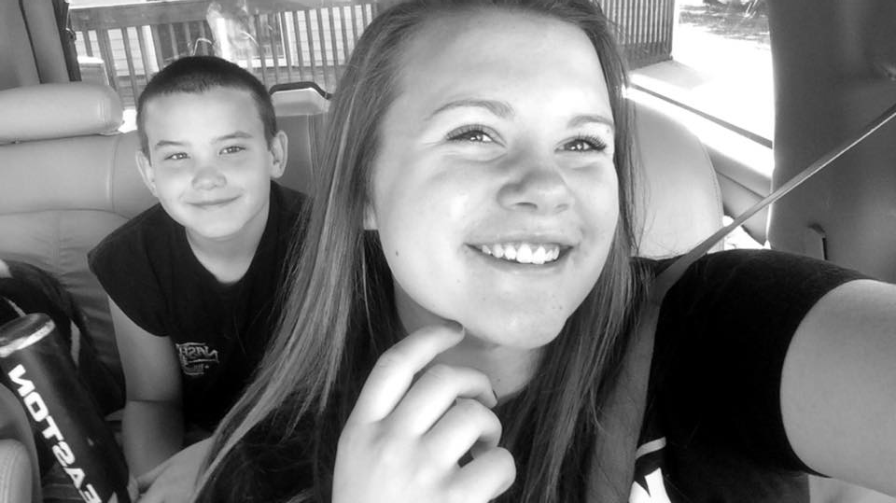
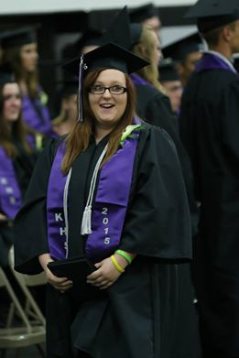
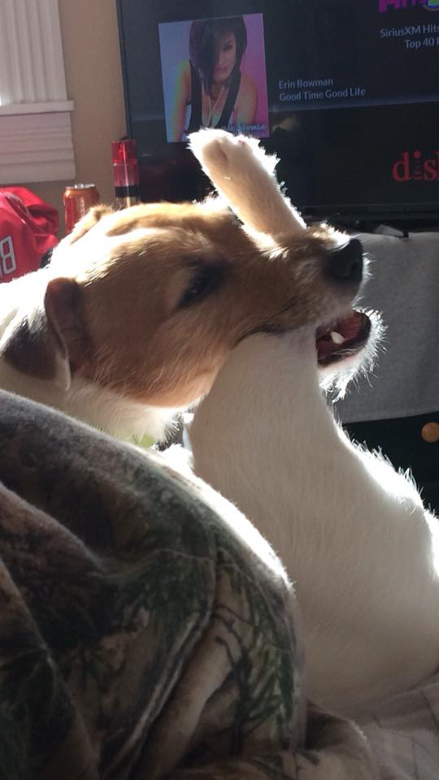
We May Not Have it All Together But Together We Have it All

Slide 11
Support, Encourage, Grow
Respected Members
I am asking for your support - Please Vote For
Jodi Wiemerslage as the 2018-2020 Midwest Region Director.
I ENVISION Great Opportunities From a Fresh Angle.
I Have a Deep Desire To Learn : To Share.
JOIN My Vision to Enrich our Region by Encouraging our Chapters
to Rely on Each Other to Influence the
Direction of the Construction Industry.

Slide 12
2018-2020 Midwest Region Director Candidate
Jodi Wiemerslage
507-696-2193
jwiemerslage@huntelec.com

Slide 13
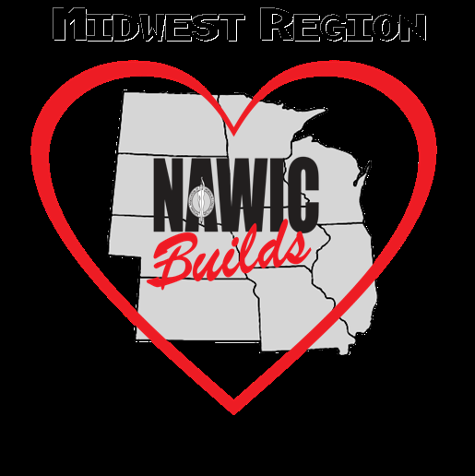
Kansas: Gr. Wichita - 120 Northeast Kansas - 142 Southeast Kansas - 382
Missouri: St. Louis - 38 Gr. Kansas City - 100 Central Missouri - 341 Southwest Missouri - 366
Illinois: Quad Cities/Moline - 50 Chicago Metro - 325
Iowa: Gr Des Moines - 80 Cedar Rapids-Iowa City - 160 Minnesota: Minneapolis/St Paul - 164 Southeast Minnesota - 346 Nebraska: Gr Omaha - 116 North Dakota: Fargo-Moorhead – 246
South Dakota: Gr Sioux Falls - 237 Black Hills - 269
Wisconsin: Milwaukee - 105

Slide 14
Thank You Midwest Region

