Slide 1
Strategic plan
NAWIC Midwest Region
2019 Spring Forum
Notes:
Welcome….
How many of you have been involved in a strategic plan process?
How many chapters have a strategic plan?
We want to thank Jodi for inviting us to talk to you about Strategic Planning. I’ll be honest with you…I am not an expert in Strategic Planning. But I do have a passion for it so I’m excited to share what I’ve learned.
We have created a plan process to help you get started and keep you on track. Important to remember, your strategic plan is a living document which means you may discover that the plan needs to be revised or updated. Our market changes. Be prepared to let go and switch strategies as needed.
The information we will be sharing can be used for your chapter or company.
Think about who will be involved in your strategic plan
Board
Committee Chairs
Open to all member
President appoints a committee that reports back to the board
However you choose to conduct, I would recommend having a facilitator/organizer or in keeping with construction terms “architect” to help keep you on tract and moving forward.
SO, LET’S GET STARTED…

Slide 2
Think big… believe big… achieve big…
Notes:
What is strategic planning and why is it important?
Strategic planning is the practice of looking forward, outside the immediate future for your organization, to reach a particular set of goals. Then it involves laying out a step-by-step how you’re going to get there.
It’s about getting from point A to point B.

Slide 3
Gather data
Study overall market
Core Purpose
Core Values
Big Audacious Goal
Internal Input
External Input
SWOT Analysis
Notes:
Before we start, we want to gather data.
The first step of any strategic planning starts with studying the overall market in which you are operating. How big is the industry? How quick is it growing? Who are the key competitors? Pricing trends? You cannot effectively plan unless you truly understand what you are up against.
Let’s review some of the data we already know which is:
Core Purpose
Core Values
Big Audacious Goal

Slide 4
NAWIC’s Core purpose
To enhance the success of women in the construction industry.

Slide 5
Core values
BELIEF in ourselves as women
PERSEVERANCE
We DARE to move into new horizons

Slide 6
Big audacious goal (bag) or vision
The association that positions women to influence the direction of the construction industry
Notes:
Vivid Description:
Women are respected leaders actively contributing to the growth and success of the construction industry.
The number of women in the industry continues to grow because it is viewed as an attractive career option.
Recognized as an industry leader, other organizations turn to NAWIC for guidance and expertise causing the association to strategically choose their collaborative partners.
Employers encourage their workers to seek education and training from NAWIC because of the proven link to professional success.
Membership in NAWIC provides opportunities for mentoring, networking, leadership development, skill advancement and learning about the latest industry trends.
Belonging to the association is a “must” for all women desiring to grow and succeed as leaders within the construction industry.

Slide 7
Gather data
Study overall market
Core Purpose
Core Values
Big Audacious Goal
Internal Input
SWOT Analysis
External Input
Notes:
Now it’s time to dig into your internal and external information.
Internal inputs – is your membership growing faster than you can onboard members? Maybe membership recruitment is fine but renewals aren’t meeting the standard expectation. Maybe you can reach a quorum at your meetings. Could it be lack of marketing, PD&E programs aren’t meeting the needs of the members, day, time, location.
External – other associations competing for members time and resources. Fast forward 12 months from now, 3-5 years, where do you see the construction industry?

Slide 8
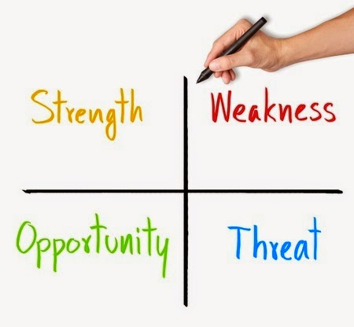
Swot analysis
Notes:
A SWOT Analysis exercise offers a helpful way to think about and organize your internal and external data. It’s a quick way of examining your Strengths, Weakness, Opportunity, and Threats.
Think of a SWOT analysis as an internal evaluation of your chapter or business.
What are your organization’s strong points?
What do you do well (sales, marketing)?
What differentiates you from your competitors?
What are your organization’s weak points?
What limitations do you face in developing or implementing your strategy?
Do you lack resources?
Member burnout or lack of onboarding new members?
What can you do better?
Where are your biggest opportunities in the future? Opportunities are situations that exist but must be acted on if the chapter is to benefit from them. What do you want to capitalize on?
What new needs could you meet?
What are the economic trends/forecast that benefit NAWIC?
What are emerging political and social opportunities?
What niches have other associations missed?
What are the largest threats to your chapter (or company)? How do you manage threats? Can you turn a threat into an opportunity?
Once you identify your SWOT, you will be able to visualize and discuss what your chapter needs to do to ensure growth and meeting the needs of a changing membership.

Slide 9
Strategic plan retreat
NAWIC Jeopardy – How well do you know NAWIC?
Review of prior year
SWOT Analysis
Membership Engagement, Benchmark, Recruitment/Retention
SMART Goals
Goal Categories
Awareness (Marketing)
Education
Infrastructure (Resources)
Membership
Notes:
You’ve gathered all the data, collected the SWOT analysis NOW WHAT?
Time to peel back the layers of the onion and decide on what specific objectives and initiatives to we need to implement to help the chapter or company achieve each of its business goals. TIME FOR A RETREAT!
Prepare a agenda

Slide 10
Framework: goal categories
Awareness (Marketing)
Education
Infrastructure (Resources)
Membership
Notes:
Develop the framework – goal categories and then start building your objectives and tactics

Slide 11
Notes:
Objectives need to be made SMART – Specific, Measurable, Attainable/Achievable, Relevant or Results-Focused and Timebound.

Slide 12
Specific
What do you want to achieve?
Have a clear outcome of the goal
Notes:
The more specific your description, the bigger the chance you’ll get exactly that.
What exactly do I want to achieve?
Where?
How?
When?
With whom?
What are the conditions and limitations?
Why exactly do I want to reach this goal?

Slide 13
Measurable
Indicator of progress
Measurable elements
Notes:
Measurable goals means that you identify exactly what it is you will see, hear, and feel when you reach your goal. It means breaking your goal down into measurable elements.
Concrete evidence.

Slide 14
Smart goal setting
ATTAINABLE
RELEVANT
Investigate
Weigh the cost, time, effort against other obligations and priorities
Why do we want to reach this goal?
Do we have the resource and skills?
Notes:
Is the goal attainable? That means investigating whether the goal is really acceptable to the board/chapter.
We weigh all the effort, time and other costs the goal will take against the profits and the other obligations and priorities we have in our chapter.
Perhaps this goal is 3-5 years out.
There’s nothing wrong with shooting for the stars. We just need to plan smart.
RELEVANT:
Does our team have the bandwidth to tackle?
Do we have the skills, resources or do we outsource or look for ways of getting them?
The main questions, why do we want to reach this goal? What is the objective behind the goal, and will this goal really achieve that?
Just because we don’t have a resource to achieve the goal now, doesn’t mean that we cannot work towards the resources needed to achieve a goal in the future. This is part of our working strategies that will follow once we set a goal. We can always allow more time if needed on a goal if necessary as well as determining a goal is no longer needed. This is all part of working the plan.

Slide 15
timely
Make a tentative plan
Deadlines
Realistic and flexible timelines
Notes:
Time is money! Important to make a tentative plan of everything we do.
Everyone needs to know deadlines – that makes most people switch to action.
Keep timeline realistic and flexible, that keeps morale high.

Slide 16
SMART + goals
Formulate POSITIVELY
FOCUS
Daily DISCIPLINE
Notes:
Another thing that’s very important when setting SMART goals, is formulating it POSITIVELY.
Remember that what you focus on, increases. So when you focus on NOT doing something, all you think about is that thing. And it will increase. Achieve a daily discipline.

Slide 17
Create the plan
Notes:
Strategy is focused on the destination and now tactics are focused on the specific actions you plan to take along the way.
Now we look at our goals – short and long term – and how we will achieve them. Smaller steps – resources, benefits, action, time frame, deadline, budget.
How are we going to get there.

Slide 18
Working the plan
Identify the drivers to achieve each goal
Committee
Task
Budget
Resources
Barriers
Lack of people
Negative attitude
Notes:
We have created a strategic plan and now what? We need to work the plan.
Look at the drivers of each goal – these are the positive things that will help get to our goal.
Identify the drivers – these are key to working the plan and keeping it moving forward. Drivers may be added to once we start moving toward the goals. All part of working the plan.
How do we break through Barriers? Start small – remember this is a 3-5 goal. Break into smaller pieces will help us accomplish us to move towards the goal.
Who are we going to assign the task to

Slide 19
scorecard
Notes:
You’ve launched your strategy now you need to know whether or not you’re making progress!
Create reports to evaluate your strategy quarterly or breaking down your strategy into pieces and reporting on one of those pieces each month.
Highlight progress on your measures and projects and how those link to your objectives.

Slide 20
Notes:
Plan refers to creating your strategic plan
Do refers to making progress on or executing on the plan
Check refers to the reporting and monitoring process
Act refers to taking action through projects, work plans, or the budgeting process to continue to manage and execute on the strategy

Slide 21
Membership strategy

Slide 22
engaging members

Slide 23
What is engagement?
Attendance at chapter meetings
Volunteer on committee / board
Sponsorship
Mentor/Mentee
Participation in Social Network
Attend National/Regional Events
Personal/Professional Development
Notes:
When I think of engagement, I think of commitment.
I recently signed up for not one but three online dating sites. It didn’t take me long to discover “fun” means something different to men. A man asked me what I was looking for and I said a long-term relationship…… I asked him the same and he said “fun”. Describe fun…”sex”.
How do you define ENGAGEMENT?
Membership Engagement is a broad term. So, if we don’t clearly establish our goals for engaging members, we will end up working toward totally disconnected goals.
So, let define “Member Engagement”
We want to be specific as possible when putting together our membership engagement strategy.
(determine a measurable, realistic goal for developing membership engagement within our chapter)
Segment membership list of like-minded member to see what trends exist among different groups. Then, design targeted opportunities and messages that are relevant and engaging to them.
Understand who are members are – plan engagement opportunities that cater to their needs and interests.

Slide 24
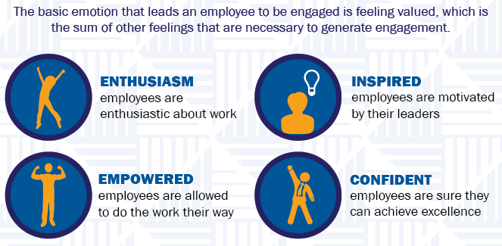
4 key emotions that lead to engagement
Notes:
A study conducted by Dale Carnegie Training showed that there are 4 key emotions that lead to engagement and experiments have shown that people are more likely to help others when feeling positive emotions. Smiling not only make us feel better but is infectious.
Analysis shows that feeling valued, confident, inspired, enthused and empowered are the key emotions that lead to engagement. Being “valued” is the gateway to achievement.
Engagement is more than being happy at work – happiness does not greatly impact engagement. Engagement is demonstrated by how personally connected and committed workers feel to their organization. It is measurable by an employee’s willingness to recommend their organization as a place to work and a place to do business.
This same holds true to NAWIC. If we as a chapter have negative emotions will our members get engaged….will they retain their membership? Negative emotions are more contagious than positive ones because they are more noticeable.
If a member or guest is uncomfortable at a dinner meeting they might feel intimidated; if a member or guest is disinterested, bored, what is the likely that they will come to another meeting; poor leadership can lead to irritation and make people upset.
We want to develop positive emotions within our chapter and association that leads to engagement.
Presidents, don’t wait till the end of your term to thank your committee chairs. This should be an ongoing process. In fact, write a note to that member’s employer and let them know what a great job they did on the committee, raising scholarship funds or the organizational/leadership skills that were demonstrated chairing a committee. Board members, give a hand-written note of thanks to show your appreciation. Committee chairs, acknowledge committee members for serving. Example: Plumblines sharing with boss

Slide 25
Membership engagement benchmark
Member event attendance.
Volunteer participation.
Social media impressions and engagements.
Email open and click-through rates.
Membership renewal.
Community-building among members.
Notes:
Percent of member attendance
Percent of volunteer participation
Percent of membership renewals
How are we going to measure?
Are goals realistic

Slide 26
Membership recruitment & retention
Notes:
Acquiring new member is a huge part of our overall membership strategy.
Membership drive – engagement opportunities – all worthwhile efforts that push our membership program forward.
If I said, let focus more on recruiting new members than on retain existing members. Is this strategy sustainable?
No. If we focus too narrowly on expansion, we lose out on a big opportunity to develop real relationships and effect change within our group’s existing community.
Now, don’t get me wrong. We don’t want to stop recruiting altogether!
Instead, look at recruitment and retention as two sides of the same coin. Consider refocusing our retention efforts:

Slide 27
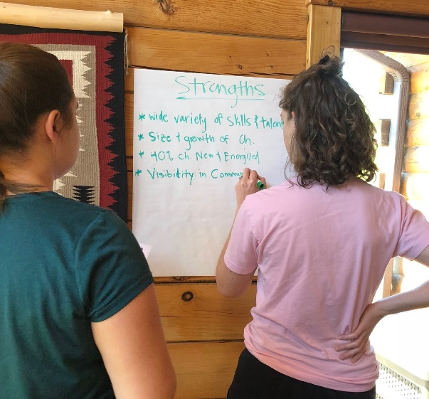
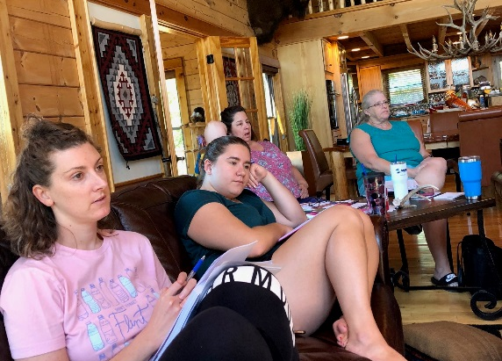
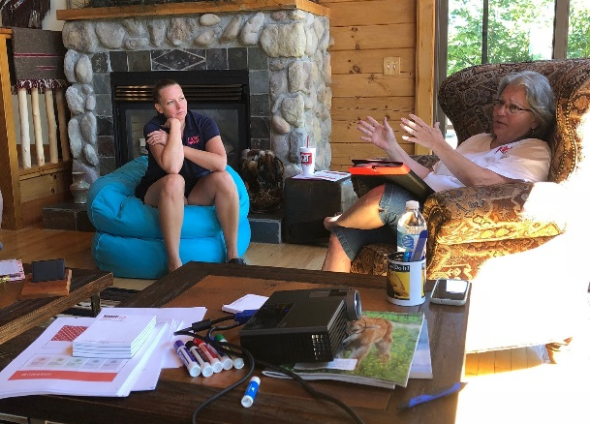

Slide 28
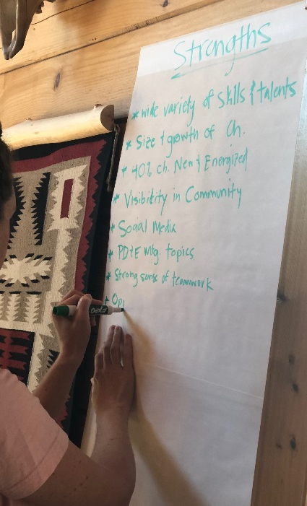
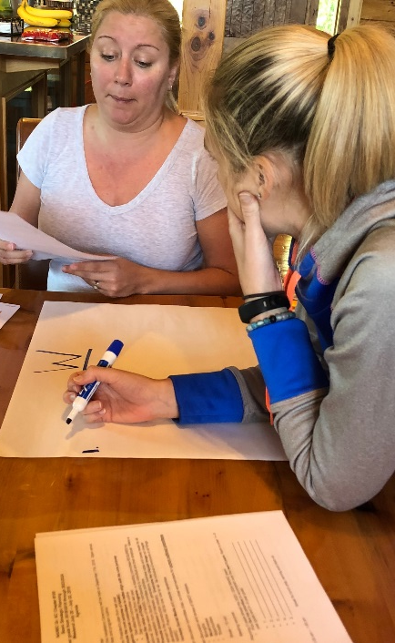
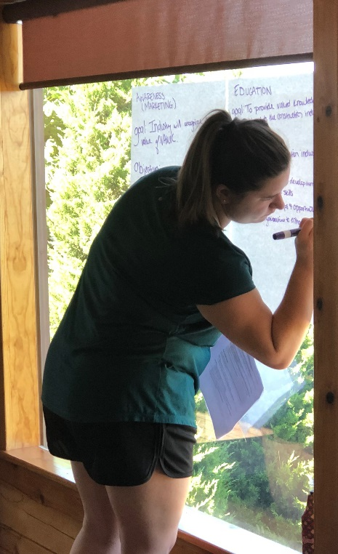

Slide 29
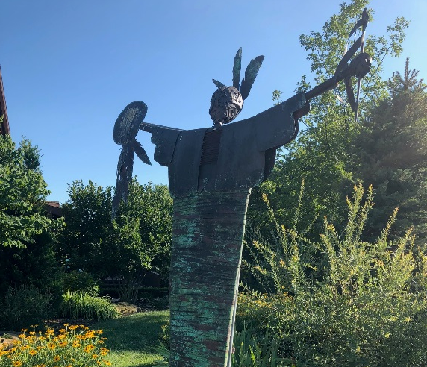
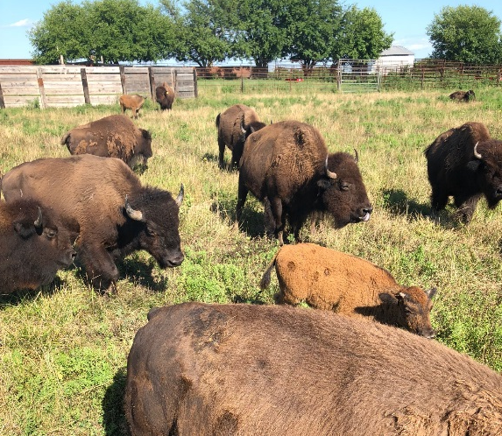

Slide 30
NAWIC…
Notes:
How do you feel with what we have accomplished today?
Are you ready to take this to the board, committee chairs, and membership.
We are embarking on an adventure!

